Slide 1
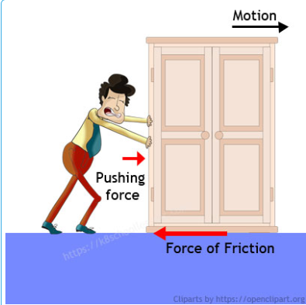
Friction Force 12-1

Slide 2
Learning Objectives
I can explain what causes friction and how it affects the motion of an object.
I can identify and describe the four types of friction.
I can give examples of the four types of friction.

Slide 3
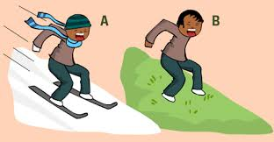
Forces: Friction
Friction is a force that opposes motion between two surfaces.

Slide 4
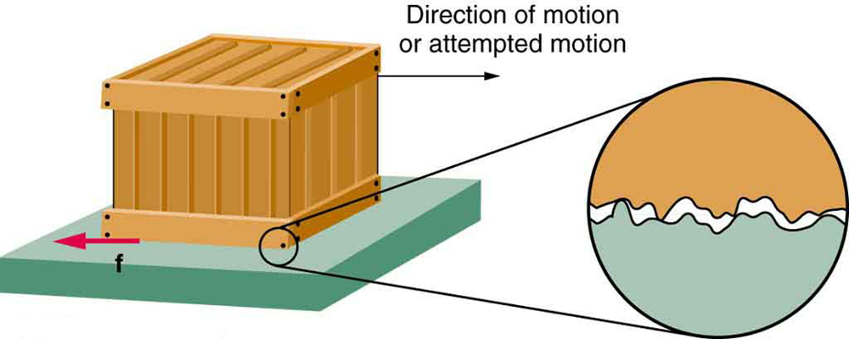
Forces: Friction
Friction occurs because the surface of any object is rough. Even surfaces that feel smooth are covered with microscopic hills and valleys.

Slide 5
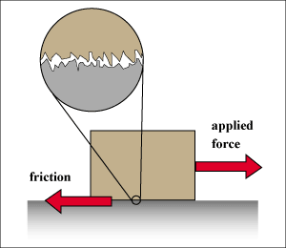
Forces: Friction
When two surfaces are in contact, the hills and valleys of one surface stick to the hills and valleys of the other surface.

Slide 6
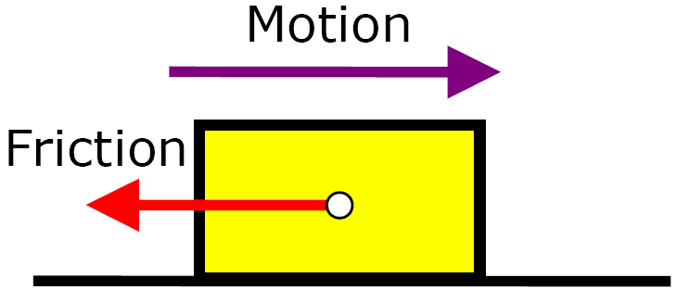
Friction Factors
The amount of friction depends on these 2 factors:
1. Roughness of the surfaces
2. The force pushing the surfaces together.

Slide 7
Will the tube roll less over a smoother surface or a rougher surface? Why?
Smooth Surface
Rough Surface
The rougher surface because there are more hills and valleys and the valleys are deeper.

Slide 8
Which has more friction and why?
The 100 pound box because the force pushing together is higher so the hills and valleys are in closer contact.
100 pounds
40 pounds

Slide 9
Friction Factors Review
1. Roughness – The rougher the surface, the more hills and valleys there are and the greater the friction.
2. Force pushing together/weight – Force is increased, the hills and valleys will be in closer contact and friction will increase.

Slide 10
Amount of Surface Area in fluids
The amount of surface area affects the friction between objects in liquids and gases. Example: Swimming

Slide 11
Surface Area in Fluids
The amount of surface area affects the friction on a moving object under the following circumstances:
air resistance (such as the size of a parachute)
the resistance of an object as it glides through water (such as a boat).

Slide 12
Surface area between Solids
The amount of surface area in contact usually does not affect friction between two solids.
- Reason larger surface areas have more contact but the pressure between the 2 is less. The increase in friction area is offset by the reduction in pressure

Slide 13
Types of Friction
1. Sliding
2. Fluid
3. Rolling
4. Static

Slide 14
Sliding Friction
Sliding friction is a friction force that opposes the direction of motion of an object that occurs when solid surfaces slide over one another.
Examples:
Writing – pencil point and paper
Combing your hair – surface of comb and strands of hair

Slide 15
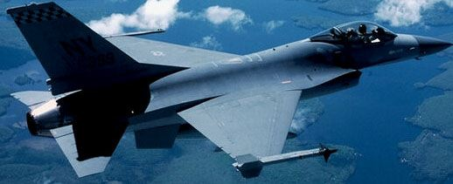
Fluid Friction
The force that tries to slow objects down when they move through a liquid or a gas. It's also known as "drag", or "air resistance".
All gases and liquids are fluids.
Fluid Friction increases as the speed of the object increases.
An airplane and a swimmer both experience fluid friction.

Slide 16
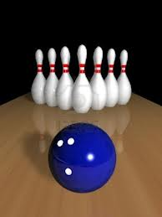
Rolling Friction
Rolling friction is friction that occurs between surfaces in motion that are rolling in which one of the surfaces is a wheel, roller, or ball.
Examples:
Riding a bike – tires and ground
Bowling – ball and lane

Slide 17
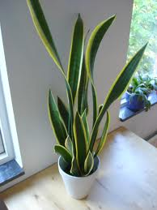
Static Friction
Static friction is friction that occurs when the surfaces in contact are at rest (not in motion).
Examples:
A book resting on a desk.
A potted plant sitting on a sidewalk.

Slide 18
Ways to Reduce Friction
Smooth the surface – less hills and valleys and there are not as deep.
Replace sliding with rolling (Use Wheels)
Add a lubricant like oil, wax, or grease – Fills in the hills and valleys.
Less force pushing together – The hills and valleys are not pushed together as hard so they have less contact.

Slide 19
Ways to Increase Friction
Rough the surface – more hills and valleys and there are not are deeper.
Replace rolling with sliding
More force pushing together – The hills and valleys are pushed together harder so the hills and valleys are in closer contact.

Slide 20
Friction Song
What is friction?
Friction Video

Slide 21
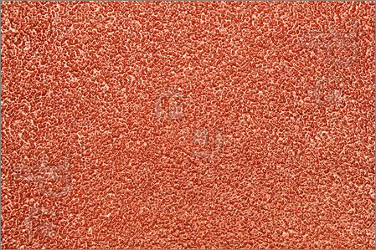
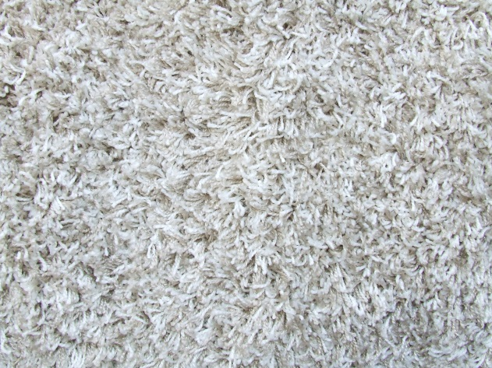
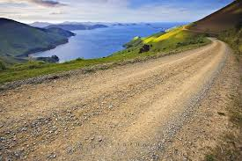
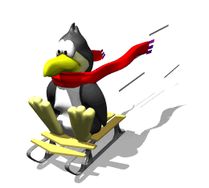
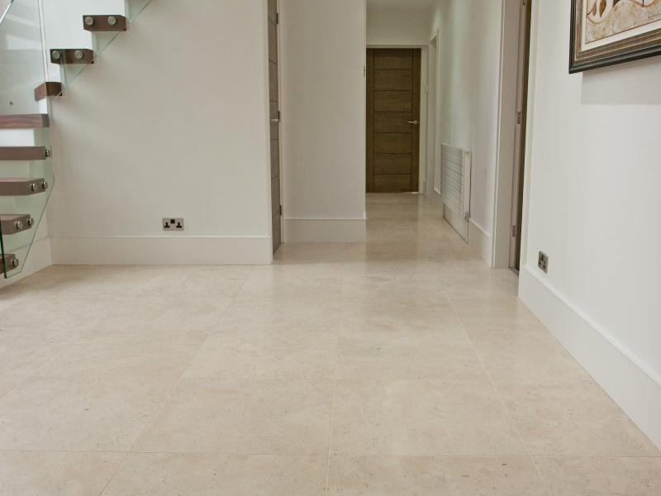
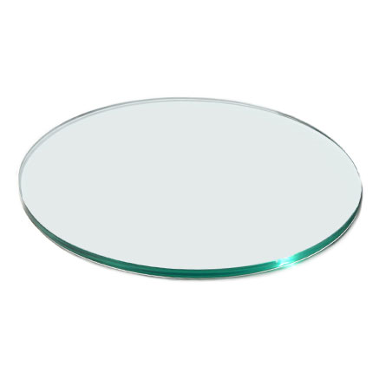
Forces: Friction
Turn to a partner and identify surfaces that may cause more friction.
Carpet
Sandpaper
Gravel
Less Friction?
ICE
Glass
Tile

Slide 22
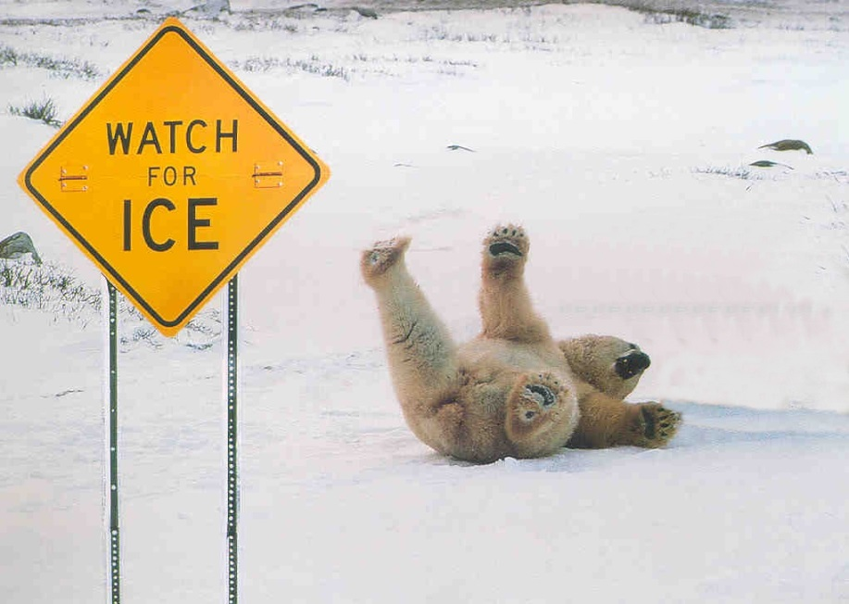
Forces: Friction
Friction is both harmful and helpful. Turn to an elbow partner and identify some examples of friction being harmful and friction being helpful.

Slide 23
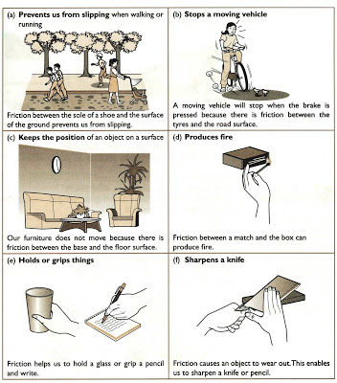
Forces: Friction

Slide 24
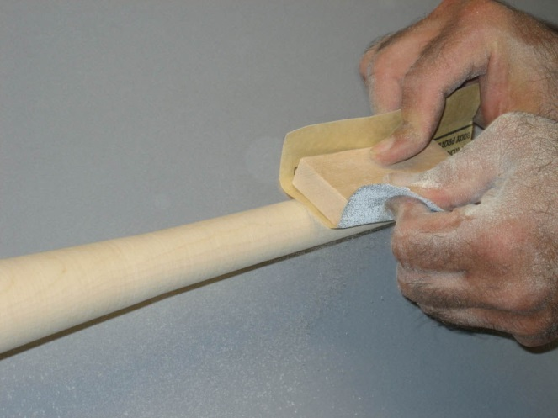
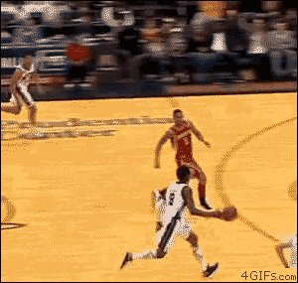
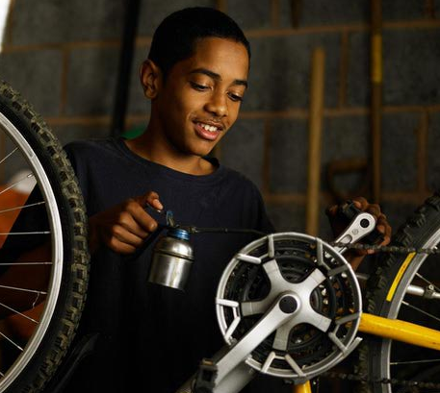
Forces: Friction
Is it beneficial to reduce or increase friction? Why or Why Not?

Slide 25
Forces: Friction
Which of the following would NOT help you move a heavy object across a concrete floor? Water, ball bearings, oil, liquid soap, steel rods, foam rubber
Name three common items you might use to increase friction.

